Slide 1
GRADE 7 ACCELERATED · UNIT 5 · LESSONS 8–9
Converting Mass, Area and Volume
MA.7.AR.3.3
I can convert mass, volume and area between systems, and square the length ratio for area.
Grade 7 Accelerated · Unit 5 · Lessons 8–9 — Converting Mass, Area and Volume
1

Slide 2





Warm-Up
1.
. How many centimeters is 12 in?
2. A figure of area
is scaled by
. The copy's area?
3. Find the product:
4.
. A 1-ft square has what area in square inches?
Grade 7 Accelerated · Unit 5 · Lessons 8–9 — Converting Mass, Area and Volume
2

Slide 3
Warm-Up
1.
. How many centimeters is 12 in?
30.48 cm
2. A figure of area
is scaled by
. The copy's area?
63 cm²
3. Find the product:
−10
4.
. A 1-ft square has what area in square inches?
144 in²
Grade 7 Accelerated · Unit 5 · Lessons 8–9 — Converting Mass, Area and Volume
3

Slide 4








Vocabulary
mass and weight
pounds and kilograms — one word on this test
ounce (oz)
a weight:
,
fluid ounce (fl oz)
a volume:
— not the same unit as the ounce
square units
,
,
— an area; the length ratio is used twice
cubic units
,
— a volume; the length ratio is used three times
Grade 7 Accelerated · Unit 5 · Lessons 8–9 — Converting Mass, Area and Volume
4

Slide 5
Notes
I. Mass and volume convert like length
Grade 7 Accelerated · Unit 5 · Lessons 8–9 — Converting Mass, Area and Volume
5

Slide 6
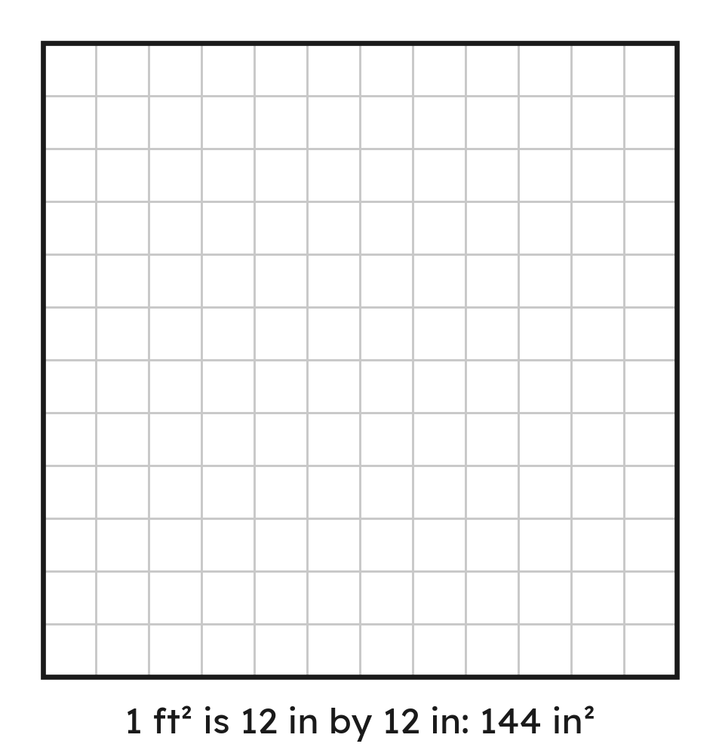
Notes
II. Area: the length ratio is used twice
Grade 7 Accelerated · Unit 5 · Lessons 8–9 — Converting Mass, Area and Volume
6

Slide 7
Notes
III. Fluid ounces go through cups
Length: the ratio once. Area: twice. Volume: three times.
Grade 7 Accelerated · Unit 5 · Lessons 8–9 — Converting Mass, Area and Volume
7

Slide 8

Example 1
. A suitcase weighs 70 lb.
How many kilograms is that?
Grade 7 Accelerated · Unit 5 · Lessons 8–9 — Converting Mass, Area and Volume
8

Slide 9
Example 1
Answer: 31.78 kg
Grade 7 Accelerated · Unit 5 · Lessons 8–9 — Converting Mass, Area and Volume
9

Slide 10
Your Turn
. A crate weighs 90 lb.
How many kilograms is that?
Grade 7 Accelerated · Unit 5 · Lessons 8–9 — Converting Mass, Area and Volume
10

Slide 11

Your Turn
. A crate weighs 90 lb.
How many kilograms is that?
Answer: 40.86 kg (about 40.9)
Grade 7 Accelerated · Unit 5 · Lessons 8–9 — Converting Mass, Area and Volume
11

Slide 12
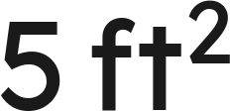
Example 2
. A tile is
in area.
How many square inches is that?
Grade 7 Accelerated · Unit 5 · Lessons 8–9 — Converting Mass, Area and Volume
12

Slide 13


Example 2
Answer: 720 in²
Grade 7 Accelerated · Unit 5 · Lessons 8–9 — Converting Mass, Area and Volume
13

Slide 14


Your Turn
. A patio is
in area.
How many square feet is that?
Grade 7 Accelerated · Unit 5 · Lessons 8–9 — Converting Mass, Area and Volume
14

Slide 15


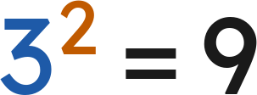

Your Turn
. A patio is
in area.
How many square feet is that?
ft² in a square yard
Answer: 45 ft²
Grade 7 Accelerated · Unit 5 · Lessons 8–9 — Converting Mass, Area and Volume
15

Slide 16

Whiteboards · Question 1 of 9
. A bag of rice is 10 kg.
How many pounds is that?
Answer it.
Grade 7 Accelerated · Unit 5 · Lessons 8–9 — Converting Mass, Area and Volume
16

Slide 17

Whiteboards · Question 1 of 9
. A bag of rice is 10 kg.
How many pounds is that?
Answer: 22.04 lb
Grade 7 Accelerated · Unit 5 · Lessons 8–9 — Converting Mass, Area and Volume
17

Slide 18
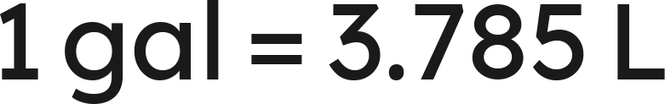
Whiteboards · Question 2 of 9
. A cooler holds 4 gal.
How many liters is that?
Answer it.
Grade 7 Accelerated · Unit 5 · Lessons 8–9 — Converting Mass, Area and Volume
18

Slide 19


Whiteboards · Question 2 of 9
. A cooler holds 4 gal.
How many liters is that?
Answer: 15.14 L
Grade 7 Accelerated · Unit 5 · Lessons 8–9 — Converting Mass, Area and Volume
19

Slide 20

Whiteboards · Question 3 of 9
. A tank holds 10 L.
How many gallons is that?
Answer it.
Grade 7 Accelerated · Unit 5 · Lessons 8–9 — Converting Mass, Area and Volume
20

Slide 21


Whiteboards · Question 3 of 9
. A tank holds 10 L.
How many gallons is that?
Answer: 2.64 gal
Grade 7 Accelerated · Unit 5 · Lessons 8–9 — Converting Mass, Area and Volume
21

Slide 22


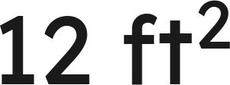
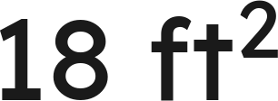
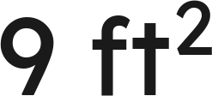
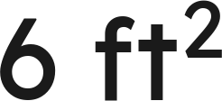
Whiteboards · Question 4 of 9
.
A patch of lawn is
in area.
How many square feet is that?
A.
B.
C.
D.
Answer it.
Grade 7 Accelerated · Unit 5 · Lessons 8–9 — Converting Mass, Area and Volume
22

Slide 23



Whiteboards · Question 4 of 9
.
A patch of lawn is
in area.
How many square feet is that?
ft² in a square yard
Answer: B — 18 ft²
Grade 7 Accelerated · Unit 5 · Lessons 8–9 — Converting Mass, Area and Volume
23

Slide 24

Whiteboards · Question 5 of 9
and
.
A bottle holds 16 fl oz.
How many liters is that?
Answer it.
Grade 7 Accelerated · Unit 5 · Lessons 8–9 — Converting Mass, Area and Volume
24

Slide 25




Whiteboards · Question 5 of 9
and
.
A bottle holds 16 fl oz.
How many liters is that?
Answer: 0.48 L
Grade 7 Accelerated · Unit 5 · Lessons 8–9 — Converting Mass, Area and Volume
25

Slide 26






Whiteboards · Question 6 of 9
.
How many square centimeters is
?
A.
B.
C.
D.
Answer it.
Grade 7 Accelerated · Unit 5 · Lessons 8–9 — Converting Mass, Area and Volume
26

Slide 27



Whiteboards · Question 6 of 9
.
How many square centimeters is
?
Answer: C — 10,000 cm²
Grade 7 Accelerated · Unit 5 · Lessons 8–9 — Converting Mass, Area and Volume
27

Slide 28

Whiteboards · Question 7 of 9
.
A 5-lb bag of flour and a 2.5-kg bag of sugar.
Which is heavier, and by how much?
Answer it.
Grade 7 Accelerated · Unit 5 · Lessons 8–9 — Converting Mass, Area and Volume
28

Slide 29


Whiteboards · Question 7 of 9
.
A 5-lb bag of flour and a 2.5-kg bag of sugar.
Which is heavier, and by how much?
Answer: The sugar, by 0.51 lb
Grade 7 Accelerated · Unit 5 · Lessons 8–9 — Converting Mass, Area and Volume
29

Slide 30

Whiteboards · Question 8 of 9
.
A 20-gal fish tank, bought for $45, is being filled.
How many liters does it hold?
Answer it.
Grade 7 Accelerated · Unit 5 · Lessons 8–9 — Converting Mass, Area and Volume
30

Slide 31


Whiteboards · Question 8 of 9
.
A 20-gal fish tank, bought for $45, is being filled.
How many liters does it hold?
Answer: 75.7 L
Grade 7 Accelerated · Unit 5 · Lessons 8–9 — Converting Mass, Area and Volume
31

Slide 32

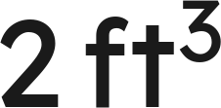


Whiteboards · Question 9 of 9
.
Priya says
is
, because
.
Name the error and fix it.
Write your answer in sentences.
Grade 7 Accelerated · Unit 5 · Lessons 8–9 — Converting Mass, Area and Volume
32

Slide 33




Whiteboards · Question 9 of 9
.
Priya says
is
, because
.
Name the error and fix it.
Answer: She used the ratio once. A cubic foot is 12 × 12 × 12 = 1,728 in³, so 2 ft³ = 3,456 in³.
Grade 7 Accelerated · Unit 5 · Lessons 8–9 — Converting Mass, Area and Volume
33

Slide 34






Independent Set
1.
. How many kilograms is 30 lb?
2.
. How many pounds is 25 kg?
3.
. How many liters is 6 gal?
4.
. How many square inches is
?
5.
and
. How many liters is 24 fl oz?
6.
. How many square meters is
? (Round to two
places.)
Grade 7 Accelerated · Unit 5 · Lessons 8–9 — Converting Mass, Area and Volume
34

Slide 35
IXL
1.
Open IXL and start today's skills.
2.
Work on paper where the question needs work. The answer box does not show it.
3.
Every skill listed is required, to a SmartScore of 67. Due at the start of the next class.
Today's skills — all required
Convert between customary and metric systems — E8Z
Compare and convert customary units — 4B8
Compare and convert metric units — HW2
Grade 7 Accelerated · Unit 5 · Lessons 8–9 — Converting Mass, Area and Volume
35

